Slide 1


GREENWORLD: Think Green for the World
Youth Education
ERASMUS+
KA220 YOU - Strategic Partnerships for Youth Education
Cooperation partnership
GREENWORLD
Module 1:
Eco Innovation and Sustainability Design
in Green Entrepreneurship
Reference Number:
2021-1-DE04-KA220-YOU-000029209
Duration:
07.03.2022 to 07.03.2024 (24 months)
Chair of Business and Human Resource Education II
Prof. Dr. Marc Beutner | Niclas C. Grüttner

Slide 2
Learning Outcomes of Module 1
The learners
explain what Entrepreneurship, Green Entrepreneurship
and Green Economy means
reflect on sustainability the need for it in European Economy
understand the chances of being an entrepreneur
describe examples of eco innovation
reflect on the importance of sustainability and eco innovation for human life
realise that Green Entrepreneurship is an option for their future life

Slide 3
Overview on the module
01
02
Introduction
Videos
to Green Entrepreneurship
Sustainability and
(Green) Entrepreneurship
03
04
Eco Innovation and Sustainability
Self-Check
Forms-Quiz
Green Economy and
Green Entrepreneurship

Slide 4

Let’s get started!

Slide 5



Introduction
01
Eco Innovation and Sustainability Design in Green Entrepreneurship
The Concept of Green Entrepreneurship

Slide 6
What is Entrepreneurship?
“Entrepreneurship is when you act upon opportunities and ideas and transform them into value for others. The value that is created can be financial, cultural, or social.”
FFE-YE –Fonden for Entreprenrørskab (2012): Impact of Entrepreneurship Education in Denmark-2011: The Danish Foundation for Entrepreneurship – Young Enterprise, Ejlskovsgade3D, 5000 Odense C, Denmark
This definition of FFE-YE was also used within the EntreCompFramework in the versions of 2016(p. 10) and the EntreCompinto Action guide of the Joint Research Centre / European Commission in 2018 (p. 176).

Slide 7

The Entrepreneurial Skills - I
To think outside of the box is important for entrepreneurs. Here are some characteristics which help to do this:
Emotional Intelligence
Ability to Understand Root Problems
Identify Causes
Innovation
Brainstorming
Technology
Think Outside the Box
Building a team

Slide 8
The Entrepreneurial Skills - II
To think outside of the box is important for entrepreneurs. Here are some characteristics which help to do this:
Building Business Plans
Critical Thinking
Decision Making
Organization
Planning
Positivity
Social Media

Slide 9
Take a look at yourself
Please, think about situation in your daily life. How do you act in this situations?
Rate the entrepreneurial skills for yourself. Where do you have fields to improve?
Take a paper and fill in a table where you rate the presented skills regarding yourself.
It should look like this:
Task
skill | Already good at it | Should be improved | Not good at all
Emotional Intelligence
Ability to Understand Root Problems
Identify Causes
…

Slide 10
Take a look at a friend of yours
Take a look at a friend who has done the last take for him-/herself as well and think
about his/her competences and skills. Take a paper and fill in the same table for him/her.
He/She should do it for you as well. It should also look like this:
skill | Already good at it | Should be improved | Not good at all
Emotional Intelligence
Ability to Understand Root Problems
Identify Causes
…
Task
Compare your ratings. Discuss with him/her similarities or differences between the own rating and the rating of the friend.

Slide 11
The Entrecomp model
The Entrecomp model builds upon a broad definition of entrepreneurship that hinges on the creation of cultural, social or economic value.
It thus embraces different types of entrepreneurship, including intrapreneurship, social entrepreneurship, green entrepreneurship and digital entrepreneurship.

Slide 12
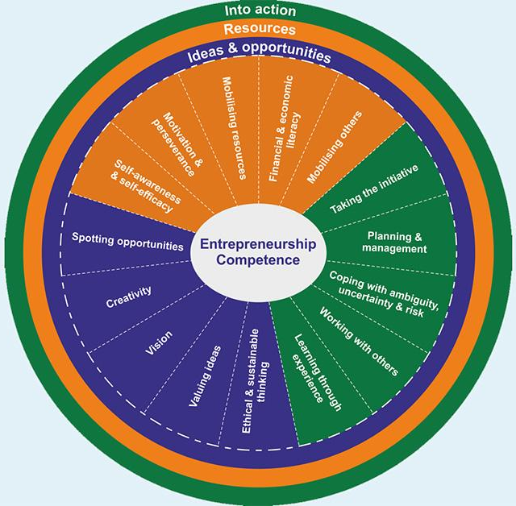
Competences in the Entrecomp model
Competence Areas
  Into action
  Resources
  Ideas and opportunities
European Commission(Ed.):
JRC Science for Policy Report: Bacigalupo,M. / Kampylis, P. / Punie, Y. / Van den Brande, G. (2016): EntreComp: The Entrepreneurship Competence Framework. European Union 2016.

Slide 13
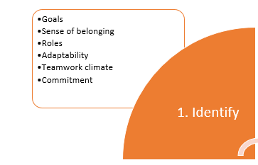
Importance of Teamwork in Green Entrepreneurship – Part I
Goals | Identifying the goals Knowledge of the goals Working towards goals
Sense of belonging | Integration within the team
Roles | Adoption Performace
Adaptability | Proposals for adaptation Adaptation of the activity
Teamwork climate | Interpersonal relations Working conditions
Commitment | Involvement in the team
Own presentation based on: cf. Torrelles Nadal, Christina; Paris Manas, Georgina; Sabrià Dernadó. Betlem; Alsinet Mora, Carles (2015): Assessing teamwork competence, Psicothema, vol. 27, no. 4, pp. 357.

Slide 14
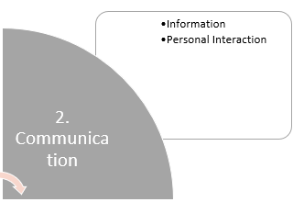
Importance of Teamwork in Green Entrepreneurship – Part II
Collaborative problem solving | Detecting conflicts Alternative proposals Conflict resolution
Negotiation | Using strategies Reaching agreements
Making improvements | Suggestions for improvements Introducing processes for improvement
Own presentation based on: cf. Torrelles Nadal, Christina; Paris Manas, Georgina; Sabrià Dernadó. Betlem; Alsinet Mora, Carles (2015): Assessing teamwork competence, Psicothema, vol. 27, no. 4, pp. 357.

Slide 15
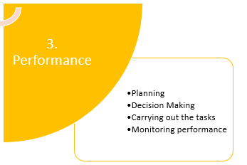
Importance of Teamwork in Green Entrepreneurship – Part III
Planning | Identify tasks Sequencing of tasks Distribution of tasks Predicting and preparing the resources required
Decision Making | Analysis for decision making Participation Consensus
Carrying out the tasks | Performing the tasks assigned Sharing Information about the difficulties encountered Participation in the resolution of contingencies
Monitoring performance | Team coordination Self-monitoring tasks
Own presentation based on: cf. Torrelles Nadal, Christina; Paris Manas, Georgina; Sabrià Dernadó. Betlem; Alsinet Mora, Carles (2015): Assessing teamwork competence, Psicothema, vol. 27, no. 4, pp. 357.

Slide 16
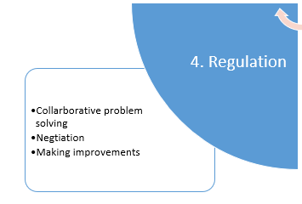
Importance of Teamwork in Green Entrepreneurship – Part IV
Information | External information search Internal information request Information sharing
Personal interaction | Personal attitude
Own presentation based on: cf. Torrelles Nadal, Christina; Paris Manas, Georgina; Sabrià Dernadó. Betlem; Alsinet Mora, Carles (2015): Assessing teamwork competence, Psicothema, vol. 27, no. 4, pp. 357.

Slide 17

Eco Innovation and Sustainability
02
Green Economy and Green Entrepreneurship

Slide 18
Sustainability? A Concept to understand it
biodiversity
resources
energy
biophysical interactions
Environment
Human diversity
Resources
equity
Quality of life
Political and organizational
structures
money and capital
employment
technological growth
investment
market forces
Society
Economy
See also: World Commission on Environment and Development, 1987

Slide 19
What is sustainable consumption?
Sustainable consumption
Has various dimensions:
  Environmental sustainability (e.g. impacts on the environment)
  Social sustainability (e.g. living conditions of local communities)
  Economic sustainability
What is sustainable consumption?
‘the use of goods and services that respond to basic needs and bring a better quality of life, while minimising the use of natural resources, toxic materials and emissions of waste and pollutants over the life cycle, so as not to jeopardise the needs of future generations'.
(1994 Oslo Symposium on Sustainable Consumption)

Slide 20

Green Entrepreneurship
Green entrepreneurship, described as a subset dedicated to solving environmental problems and promoting social change, highlights the intertwining dimensions of entrepreneurship, business, social, socioeconomic, and environmental aspects.
(Block et al., 2023 )

Slide 21
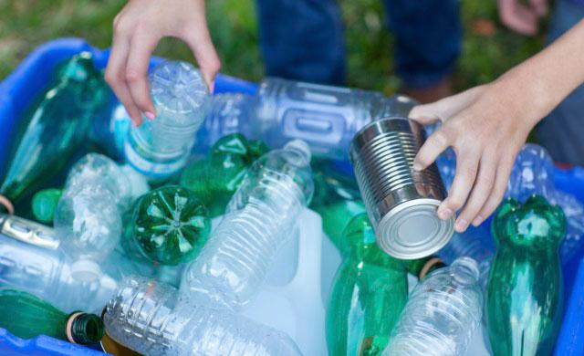

Ideas for green entrepreneurship
Waste Management/Recycling Business
Recycling is a great step towards ensuring that toxic waste does not end up in the landfills. An electronics recycling business is a great area as old computers, mobile phones, fax machines as well as outdated television sets can be used to produce items that can be used elsewhere. You can also consider offering a pickup service for such electronics and deliver them to recyclers at a fee even though you may not offer actual recycling services.

Slide 22

Videos
03
Sustainability and (Green) Entrepreneurship

Slide 23
Sustainability
Watch the following Videos and take Notes

Slide 24
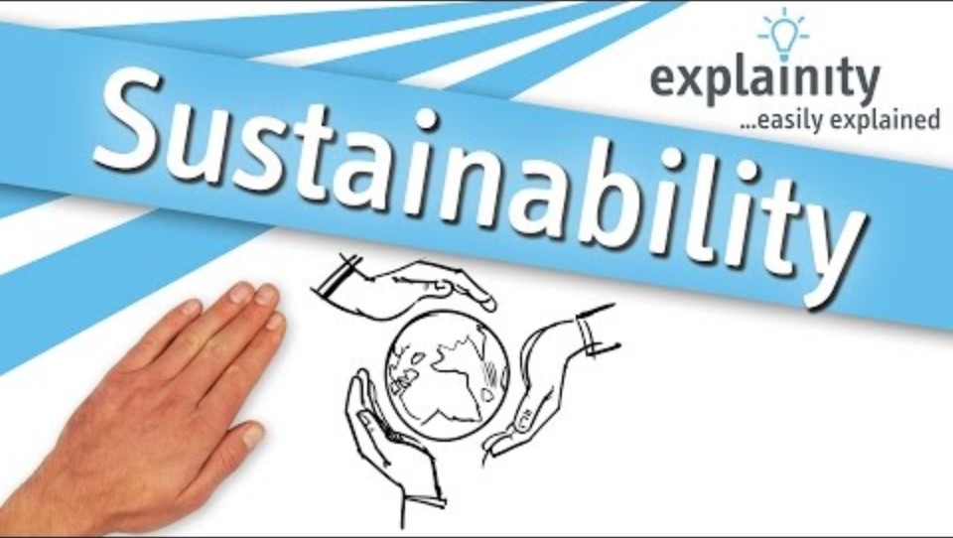
Sustainability explained
Please Watch the Video
Take notes on the important facts
What does Sustainability include?
Task
https://www.youtube.com/watch?v=_5r4loXPyx8

Slide 25
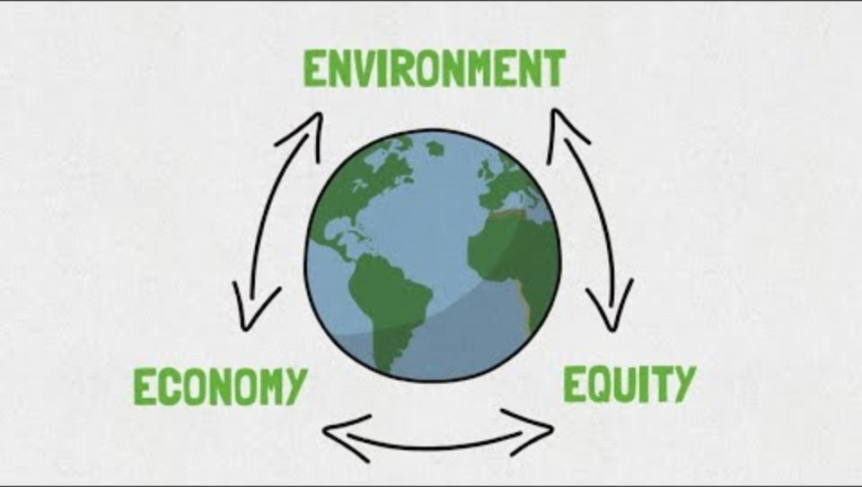
What is Sustainability ?
Please Watch the Video
Take notes on the important facts
What is Sustainability and how is it defined?
Task
https://www.youtube.com/watch?v=zx04Kl8y4dE

Slide 26
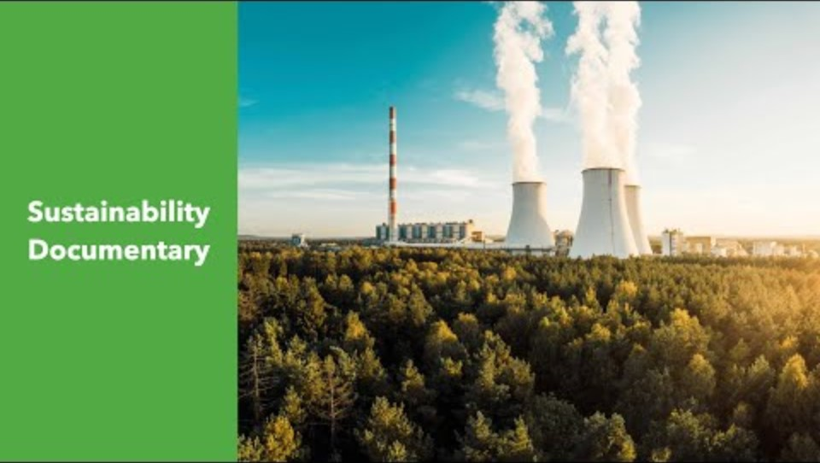
Sustainability documentary
Please Watch the Video
Take notes on the important facts
What are unsustainable systems?
Task
https://www.youtube.com/watch?v=bjrPiIem30g

Slide 27
(Green)
Entrepreneurship
Watch the following Videos and take Notes

Slide 28

What is an Entrepreneur?
Please Watch the Video
Take notes on the important facts
Find a definition of what an entrepreneur is
Task
https://www.youtube.com/watch?v=rRpMrAMesbA

Slide 29

10 Characteristics of Successfull Entrepreneurs
Please Watch the Video
Take notes on the important facts
Make a list of the important characteristics an entrepreneur should have
Task
https://www.youtube.com/watch?v=-sQeREfZY-8

Slide 30
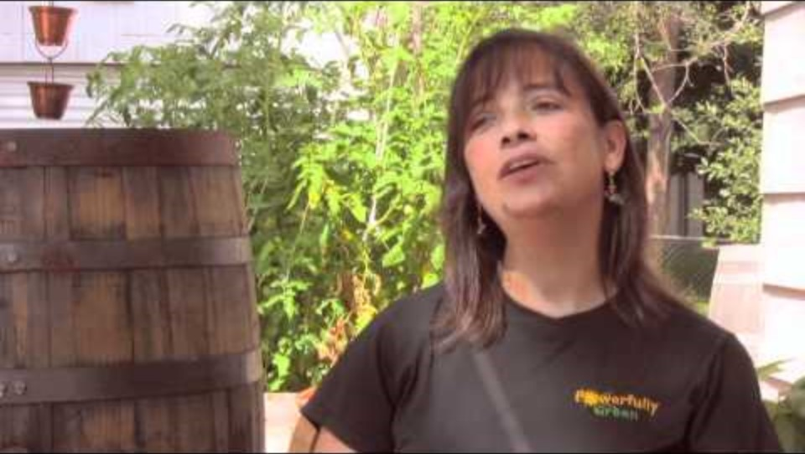
Green Entrepreneurship
Please Watch the Video
Take notes on the important facts
What is green entrepreneurship and how does it divide from “non-green” entrepreneurship?
Task
https://www.youtube.com/watch?v=dV7vAIMNhII

Slide 31

Self-Check
04
Eco Innovation, Sustainability and Green Entrepreneurship

Slide 32
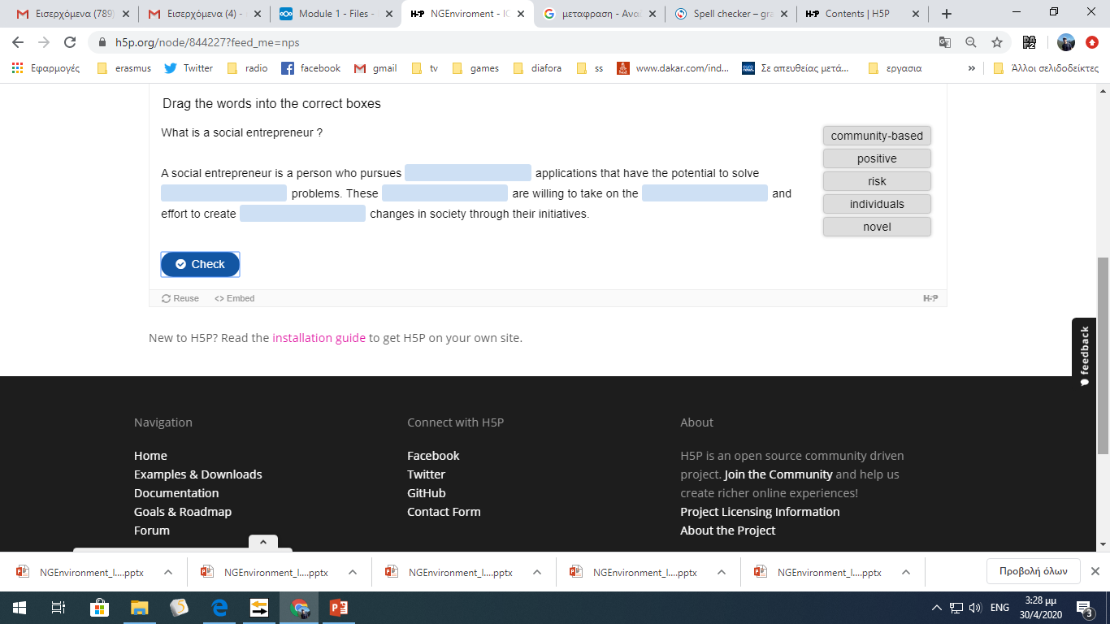
Self
Check

Slide 33
Fill in the gaps with the appropriate words
Entrepreneurship Green Entrepreneurship Green Economy
Self
Check
refers to the process of starting a business or organization with the aim of creating value and making a profit. Green Entrepreneurship specifically focuses on environmentally sustainable business practices, while Green Economy encompasses all economic activities that promote environmental sustainability and the efficient use of resources.

Slide 34
Which term specifically focuses on environmentally sustainable business practices?
A) Entrepreneurship
B) Green Economy
C) Sustainable Innovation
D) Green Entrepreneurship
Self
Check
Notes:
Answer: B

Slide 35
What does a circular economy aim to achieve?
A) Maximize waste production
B) Minimize resource efficiency
C) Minimize waste and maximize resource efficiency
D) Ignore environmental concerns
Self
Check
Notes:
Answer: C

Slide 36
How does sustainability contribute to economic growth?
A) By depleting natural resources
B) By fostering innovation and creating eco-friendly markets
C) Through excessive waste production
D) By ignoring environmental concerns
Self
Check
Notes:
Answer: B

Slide 37
What qualities are essential for being a successful entrepreneur?
A) Complacency and rigidity
B) Creativity, adaptability, and perseverance
C) Strict adherence to tradition
D) Aversion to risk-taking
Self
Check
Notes:
Answer: B

Slide 38
Write a comprehensive essay (about 3000 words) on sustainability, exploring its environmental, economic, and social dimensions.
Address challenges, opportunities, and real-world examples.
Discuss the role of education, technology, and ethics in promoting sustainability.
Analyse global challenges and the importance of international collaboration and policies.
Conclude with a compelling argument for embracing sustainability and propose avenues for future action.
Self
Check
Notes:
Evaluation Criteria:
Understanding and analysis of sustainability concepts.
Use of credible sources and examples.
Clarity and coherence of arguments.
Thoughtfulness in addressing challenges and proposing solutions.
Overall quality of writing, including grammar and structure.

Slide 39
References and Links
Bocken, N. M. P., Geradts, T. H. J., (2020). Barriers and drivers to sustainable business model innovation: Organization design and dynamic capabilities. Long Range Planning, 53(4), 101950. https://doi.org/10.1016/j.lrp.2019.101950
Bijedić, T. (2019). Begriffliche und disziplinäre Genese der Entrepreneurship Education. In Bijedić, T., Ebbers, I., & Halbfas, B. (Eds.). (2019). Entrepreneurship Education: Begriff - Theorie - Verständnis (1st ed.). Springer Gabler Wiesbaden. https://doi.org/10.1007/978-3-658-27327-9
Bijedić, T., Ebbers, I., & Halbfas, B. (Eds.). (2019). Entrepreneurship Education: Begriff - Theorie - Verständnis (1st ed.). Springer Gabler Wiesbaden. https://doi.org/10.1007/978-3-658-27327-9
Block, J. H., Halberstadt, J., Högsdal, N., Kuckertz, A., & Neergaard, H. (2023). The Future of Entrepreneurship Education and Training: Some Propositions. In Block, J. H., Halberstadt, J., Högsdal, N., Kuckertz, A., & Neergaard, H. (Eds.), Progress in Entrepreneurship Education and Training (FGF Studies in Small Business and Entrepreneurship). Springer, Cham. https://doi.org/10.1007/978-3-031-28559-2_1
Cope, J. (2005). Toward a Dynamic Learning Perspective of Entrepreneurship. Entrepreneurship Theory and Practice, 29(4), 373-397. https://doi.org/10.1111/j.1540-6520.2005.00090.x
Dentchev, N., Rauter, R., Jóhannsdóttir, L., Snihur, Y., Rosano, M., Baumgartner, R., Nyberg, T., Tang, X., van Hoof, B., & Jonker, J. (2018). Embracing the variety of sustainable business models: A prolific field of research and a future research agenda. Journal of Cleaner Production, 194, 695-703. https://doi.org/10.1016/j.jclepro.2018.05.156

Slide 40
References and Links
European Commission (2011). Innovation for a sustainable Future - The Eco-innovation Action Plan (Eco-AP) (COM(2011) 899 final). Brussels: European Commission.
EuropeanCommission (Ed.): JRC Science for Policy Report: Bacigalupo,M. / Kampylis, P. / Punie, Y. / Van den Brande, G. (2016): EntreComp: The Entrepreneurship Competence Framework. European Union 2016.
Ffe-Ye –Fonden for Entreprenrørskab (2012): Impact of Entrepreneurship Education in Denmark-2011: The Danish Foundation for Entrepreneurship – Young Enterprise, Ejlskovsgade3D, 5000 Odense C, Denmark
Torrelles Nadal, Christina; Paris Manas, Georgina; Sabrià Dernadó. Betlem; Alsinet Mora, Carles (2015): Assessing teamwork competence, Psicothema, vol. 27, no. 4
United Nations (1987). Report of the World Commission on Environment and Development Our Common Future. Accessed via: chrome-extension://efaidnbmnnnibpcajpcglclefindmkaj/https://gat04-live-1517c8a4486c41609369c68f30c8-aa81074.divio-media.org/filer_public/6f/85/6f854236-56ab-4b42-810f-606d215c0499/cd_9127_extract_from_our_common_future_brundtland_report_1987_foreword_chpt_2.pdf

Slide 41
Contact
Universität Paderborn
Department Wirtschaftspädagogik Lehrstuhl Wirtschaftspädagogik II Warburger Str. 100
33098 Paderborn
http://www.upb.de/wipaed
Prof. Dr. Marc Beutner
Tel: +49 (0) 52 51 / 60 - 23 67
Fax: +49 (0) 52 51 / 60 - 35 63
E-Mail: marc.beutner@uni-paderborn.de

