Slide 1
GREENWORLD: Think Green for the World Youth Education ERASMUS+ KA220 YOU - Strategic Partnerships for Youth Education Cooperation partnership
GREENWORLD
Module 4: User Experiences of Green Companies
Reference Number: 2021-1-DE04-KA220-YOU-000029209
Duration:
07.03.2022 to 07.03.2024 (24 months)

Slide 2
Learning Outcomes of Module 3
The learners
Understand global green actions made by governments.
Understand green actions of International communities (such as UN, and EU).
Define the meaning of green companies.
Analyze how companies evolve to ‘green’.
Identify the effect of green companies on consumer behaviors.
Analyze ecological purchasing behaviors.
Define the concept of ’greenwashing’
Analyze how companies use ‘greenwashing’ methods.

Slide 3
Let’s get started!

Slide 4
Introduction
01
User Experiences of Green Companies

Slide 5
Why Has Being ‘Green’ Become So Important?
Since the middle of the twentieth century there has been a dramatic increase in the consumption of resources such as water, mineral fertilizers, fossil fuels, paper, as well as increased levels of deforestation and greenhouse gas emissions, particularly CO2 (Biloslavo and Trnavcevic, 2014, p. 1
158)
This increased usage both non-renewable energy sources and greenhouse gas emissions have led to ecological and climate issues

Slide 6
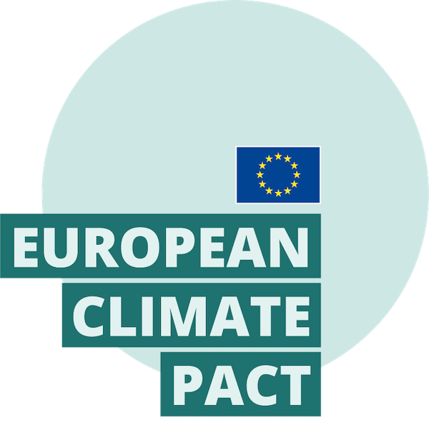
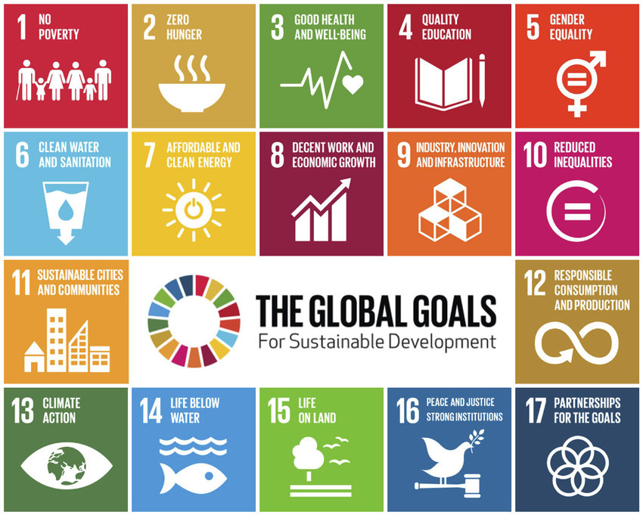
Recently, many regulations have been made to eliminate greenhouse gas emissions by political and international authorities. These are;
Kyoto Protocol (1997)
UN Sustainable Development Goals (UN SDGs)
European Climate Pact
These efforts carried out by international bodies and governments push companies to modernize their technologies making products eco-friendly accordingly to SDGs principals and regulations.

Slide 7
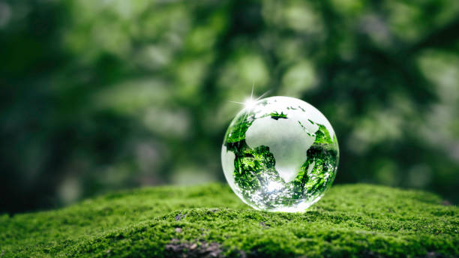
Concept of Green Companies
Based on companies’ response to the question of environment, they can be divided into three groups:
Green Companies
Companies on the way to becoming green
Others

Slide 8
How Companies Evolve Towards Green?
Green Company: The green company could be defined as a company whose purpose, activities and its own material existence are in full harmony with the natural and cultural environment, and whose employees strictly follows ethical rules in relation and communication among themselves and with the company’s stakeholders (Biloslavo and Trnavcevic, 2014, p. 1159).

Slide 9
Companies can implement their processes towards becoming a green company in three different ways:
production of sustainable products
usage of renewable energies in the production process
Or materials reduction
Companies continue their journey towards becoming a green company through areas such as environmental strategies and green products.

Slide 10
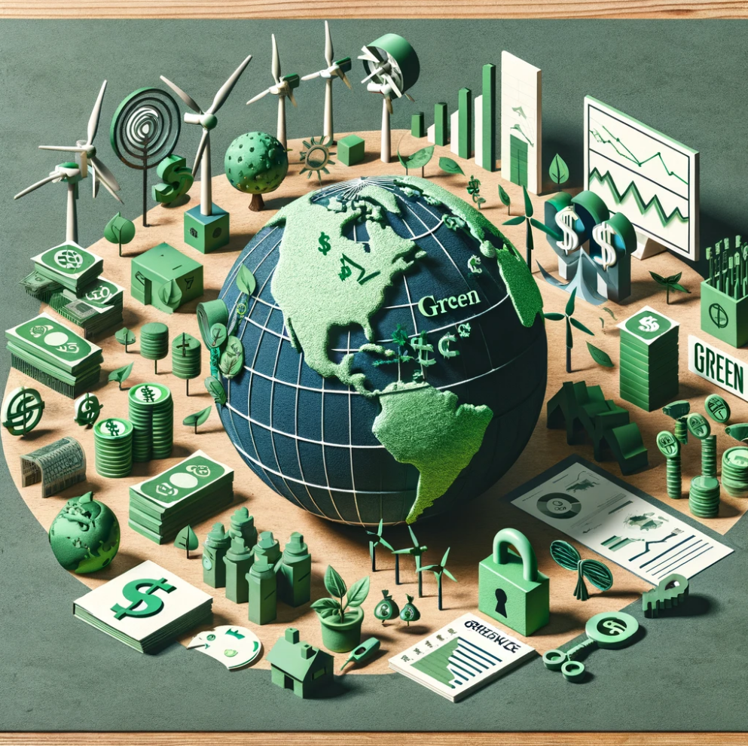
Change in Consumer Behaviors Based on Green Companies
Key Statistics:
-78% of consumers feel that sustainability is important.
-84% of customers say that poor environmental practices will alienate them from a brand or company.
Source: TheRoundup.org, December 2023
Based on literature research, it has been determined that green practices are effective in consumers' purchasing behaviour due to their environmental concerns (Bozpolat, 2021, p. 721). In recent years, green management and environmentalism have become one of the most debated topics as a form of social responsibility.

Slide 11
Reasons for the Change in Consumer Behaviors;
Intensive industrial manufacturing leading to uncontrollable environmental pollution being recognized by society
Emphasizes made by public bodies, international organizations and governments made on this issue increase the social awareness of the society
With the increase of awareness of social responsibility there is a shift in consumer behaviors.
Long-term satisfaction is experiences by the consumers when they buy eco-friendly products. Customers who prefer green companies are more satisfied than others.
Considering the harm to the nature and environment in purchasing behavior has become a social and unwritten norm.

Slide 12
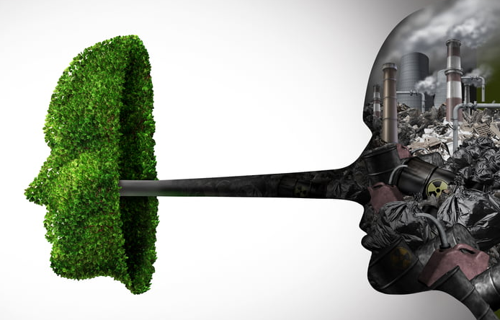
‘Green Washing’
Green Washing: Greenwashing occurs when a company claims to be environmentally responsible but lacks sufficient evidence or actions to support these claims.

Slide 13
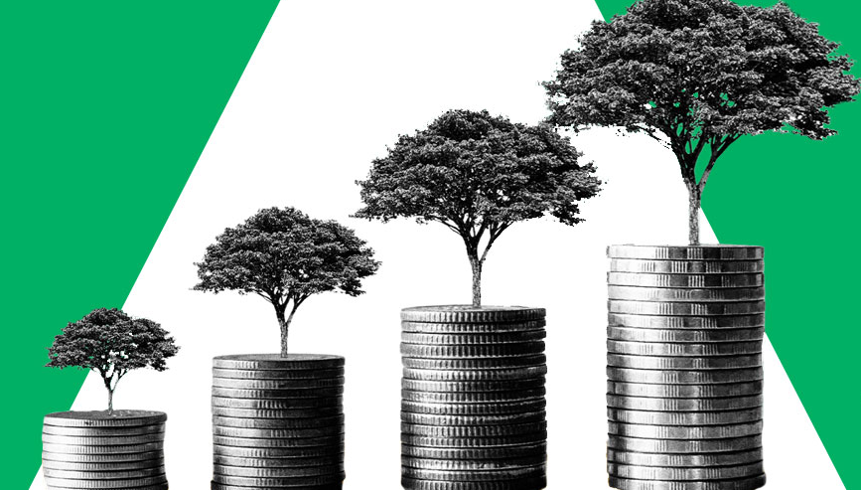
How to Understand Green Washing?
-If the product remains unchanged,
-If there are no changes in the production from the aspect of the
-If environmental policy of the company,
if the company acquires only a new outfit

Slide 14
Objectives of the Module
User Experiences of Green Companies
Exploring Green Company Concepts:
Define and differentiate between green companies, companies in transition towards becoming green, and others.
Examine the criteria and characteristics that categorize a company as 'green,' emphasizing alignment with natural and cultural environments, adherence to ethical standards, and commitment to financial, social, and environmental sustainability.
Understanding Consumer Behaviour towards Green Companies:
Analyse the influence of green practices and environmental concerns on consumer purchasing behavior.
Explore the societal shift towards eco-friendly attitudes and the growing importance of environmental responsibility in consumer decision-making processes.
Investigate the correlation between green purchasing behaviour, customer satisfaction, and long-term consumer loyalty towards environmentally conscious brands.
Identifying Greenwashing and Its Impacts:
Define greenwashing and its implications for consumer trust, corporate reputation, and market dynamics.
Examine case studies and real-world examples illustrating the consequences of greenwashing on company profitability, investor confidence, and consumer behaviour.
Discuss strategies for combating greenwashing, emphasizing the importance of transparency, authenticity, and genuine commitment to environmental sustainability in business practices.
Task

Slide 15
References and Links
Biloslavo, R., & Trnavčevič, A. (2009). Web sites as tools of communication of a “green” company. Management Decision, 47(7), 1158-1173.
Albino, V., Balice, A., & Dangelico, R. M. (2009). Environmental strategies and green product development: an overview on sustainability‐driven companies. Business strategy and the environment, 18(2), 83-96.
Bradbury, H. and Clair, J. (1999), “Promoting sustainable prganizations with Sweden’s Natural Step”, Academy of Management Executive, Vol. 13 No. 4, pp. 63-74.
BERBER, G., & ÖZTÜRK, A. (2023). Yeşil Pazarlama Çalışmalarının Tüketiciler ve İşletmeler Açısından Değerlendirilmesi Üzerine Bir İçerik Analizi. İnsan ve Toplum Bilimleri Araştırmaları Dergisi, 12(5), 2687-2707.
Bozpolat, C. (2021). Çevresel Kaygının ve Algılanan Pazar Etkisinin Yeşil Ürün Satın Alma Davranışındaki Rolü. Kafkas Üniversitesi İktisadi ve İdari Bilimler Fakültesi Dergisi, 12(24), 702-727.
Çavuşoğlu, Sinan. (2021). Yeşil Reklam ve Yeşil Marka Farkındalığın Yeşil Müşteri Tatmini Üzerindeki Etkisi: Yeşil Satın Alma Davranışının Aracılık Rolü. Gaziantep University Journal of Social Sciences. 20. 1355-1374. 10.21547/jss.893209.
Pimonenko T, Bilan Y, Horák J, Starchenko L, Gajda W. 2020, Green Brand of Companies and Greenwashing under Sustainable Development Goals. Sustainability, 12(4):1679. https://doi.org/10.3390/su12041679

