Slide 1
GREENWORLD: Think Green for the World Youth Education ERASMUS+ KA220 YOU - Strategic Partnerships for Youth Education Cooperation partnership
GREENWORLD
Module 4: Developing and Analyzing Access to Finance for Green Entrepreneurs
Reference Number: 2021-1-DE04-KA220-YOU-000029209
Duration:
07.03.2022 to 07.03.2024 (24 months)

Slide 2
Learning Outcomes of Module 4
The learners
Define the concept of green finance.
Identify sources and instruments of green finance.
Analyze challenges and opportunities in accessing green finance.
Develop strategies for securing green finance.
Apply knowledge in real-world scenarios.
Contribute to Sustainable Development Goals (SDGs) through green finance.
Foster innovation and entrepreneurship in the green finance sector.

Slide 3
Let’s get started!

Slide 4
Introduction
01
Developing and Analyzing Access to Finance for Green Entrepreneurs
Navigating the Pathway to Sustainable Economic Development

Slide 5
The concept of green finance represents a transformative approach to redefining financial markets with a focus on sustainability and ecological preservation. In an era where environmental challenges loom large, green finance emerges as a crucial mechanism to support projects that contribute to a sustainable future. From renewable energy initiatives to innovative sustainable technologies, green finance enables entrepreneurs to integrate sustainable practices into the very fabric of their business models. This commitment is pivotal in our collective effort to combat climate change, promote environmental stewardship, and foster a green economy.

Slide 6
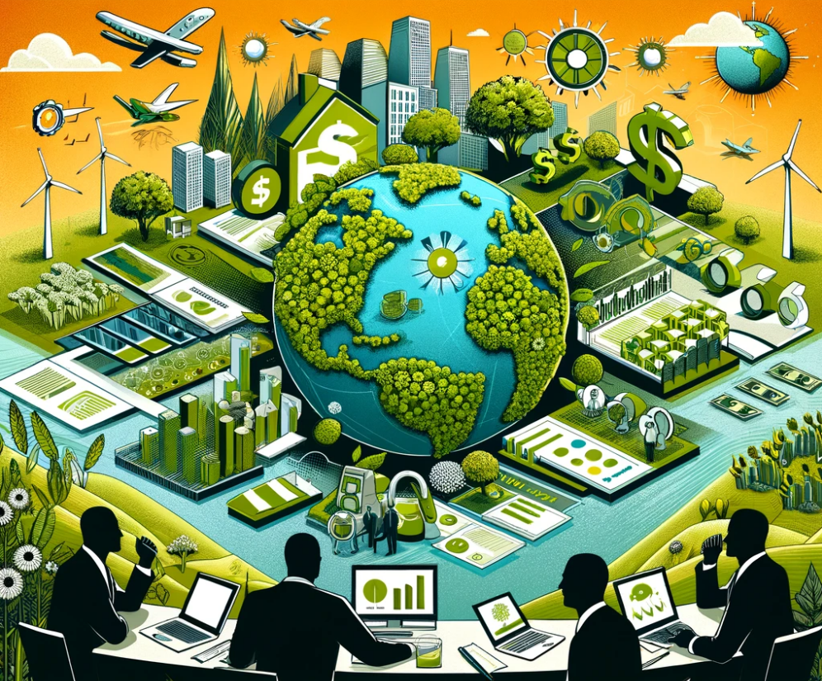
As we embark on this journey, understanding the intricacies of green finance becomes imperative for entrepreneurs who are dedicated to making a positive impact. This module aims to demystify the complexities of accessing and leveraging green finance, providing you with the knowledge and tools to drive your sustainable ventures forward.

Slide 7
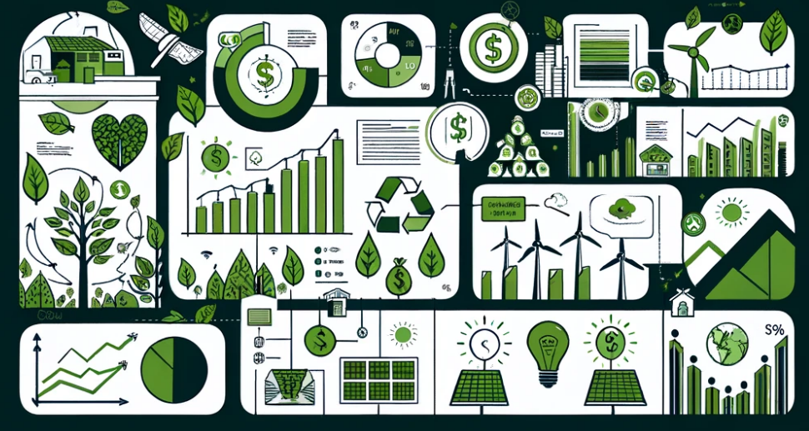
Concept of Green Finance
Catalyzing Sustainable Growth and Environmental Stewardship
To think outside of the box is important for entrepreneurs. Here are some characteristics which help to do this:
Green finance is the linchpin in the quest for environmental sustainability and economic prosperity. It encompasses a broad range of financial products and services designed to support projects that have a positive impact on the environment.

Slide 8
This innovative financing mechanism is pivotal for:
Reducing Carbon Emissions: By funneling investments into renewable energy projects, such as solar and wind power, green finance plays a critical role in the global effort to mitigate climate change.
Promoting Sustainable Technologies: It provides the much-needed capital for developing and deploying technologies that are crucial for a sustainable future, from energy-efficient appliances to sustainable agriculture practices.
Integrating Sustainable Practices: Green finance encourages businesses to adopt sustainable practices, ensuring that environmental stewardship becomes a core component of their business models.
Driving Economic Growth: Beyond its environmental impact, green finance also contributes to economic development by creating jobs in the green economy and fostering innovation in sustainable technologies.

Slide 9
Objective of the Module
Empowering Entrepreneurs with Green Finance Insights
Demystifying Green Finance: Breaking down complex financial concepts to make green finance accessible and understandable for entrepreneurs.
Tailored Learning: Offering insights and strategies specifically relevant to entrepreneurs keen on embedding sustainability into their ventures.
Practical Application: Guiding participants through the process of accessing, analyzing, and utilizing green financial instruments to support and scale their green projects.
Fostering Innovation: Encouraging the adoption of innovative sustainable technologies and practices through informed financial decision-making.
Impactful Outcomes: Equipping entrepreneurs with the knowledge and tools necessary to contribute meaningfully to environmental sustainability and the green economy.
Task

Slide 10
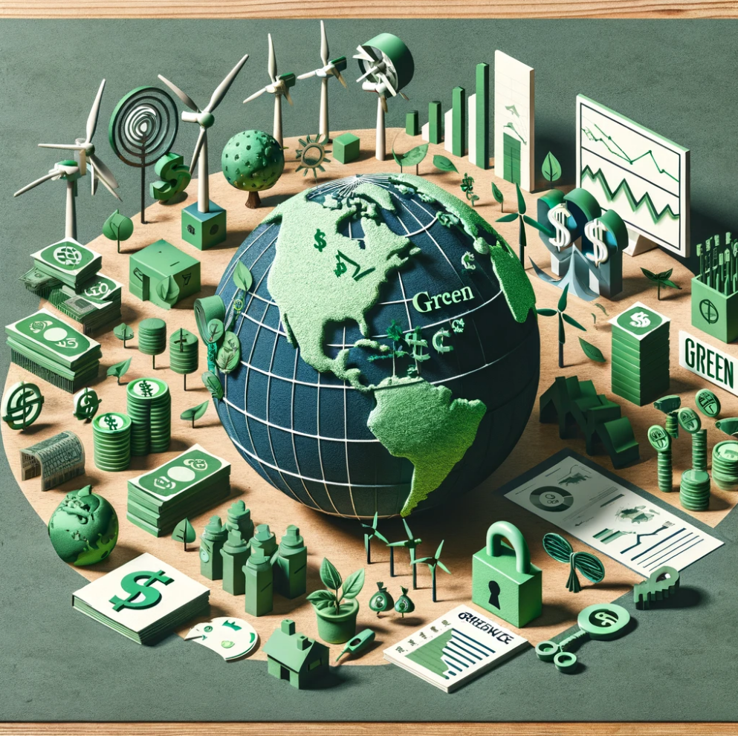
Navigating the Landscape of Sustainable Finance
Green finance represents a critical juncture in the movement towards a sustainable future, characterized by its dynamic and multifaceted nature.
Understanding the dynamics of green finance is essential for entrepreneurs looking to make a significant impact on environmental sustainability. By leveraging the opportunities and overcoming the challenges presented by this complex ecosystem, businesses can contribute to a more sustainable and prosperous future.

Slide 11
Sources of Green Finance: From international funds to green bonds and private investments, the variety of sources reflects the growing commitment of the financial sector to sustainability.
Opportunities for Growth: Green finance offers unparalleled opportunities for businesses to innovate, grow, and contribute positively to the environment. It supports projects ranging from renewable energy to sustainable agriculture, driving forward the green economy.
Challenges to Access: Despite its potential, entrepreneurs often face challenges in accessing green finance due to regulatory hurdles, market immaturity, and the need for specialized knowledge to navigate this space.
Policy Frameworks: Government policies and international agreements play a pivotal role in shaping the green finance landscape, providing incentives and frameworks that encourage sustainable investment.
Innovation as a Catalyst: Innovation in technology and financial products is essential for advancing the green economy, enabling new forms of investment and support for sustainable projects.

Slide 12
Learning Elements
Building Blocks of Green Finance Knowledge
Comprehension of Green Finance: Understanding the fundamental concepts and global importance of green finance in driving sustainable development.
Identification and Utilization of Sources: Learning to navigate the diverse sources of green finance, including green bonds, grants, and loans, and how to effectively utilize them for sustainable ventures.
Overcoming Challenges: Addressing the common barriers to accessing green finance, from financial constraints to regulatory hurdles, and developing strategies to overcome these obstacles.
Leveraging Opportunities: Identifying and capitalizing on the unique opportunities that green finance presents for sustainable business growth and environmental impact.
Strategic Financing: Crafting compelling proposals and navigating the green finance landscape to secure funding, with an emphasis on innovation and partnerships.

Slide 13
Sources of Green Finance
Green finance helps turn eco-friendly ideas into reality. Here’s how:
Green Bonds: These are special bonds issued to fund projects that have positive environmental benefits. Think of them as loans for the planet.
Grants: Free money given by governments, organizations, or foundations to support environmental projects. It’s like a financial gift for doing good.
Loans: Borrowed money that must be paid back but is specifically for funding green initiatives.

Slide 14
Sectors Benefiting from Green Finance:
Renewable Energy: Solar panels, wind turbines, and hydro power.
Sustainable Agriculture: Farming that’s good for the earth.
Eco-Friendly Transportation: Electric cars, bikes, and public transport systems.

Slide 15
Challenges and Opportunities in Accessing Green Finance
Challenges:
Financial Constraints: Finding enough money to start or grow green projects can be tough.
Regulatory Hurdles: Sometimes, laws and regulations make it hard to get green finance.
Early Market Stage: The green finance market is still growing, making it a bit tricky to navigate.

Slide 16
Opportunities:
Sustainable Business Growth: Green finance helps businesses grow while being good to the planet.
Innovation Support: It provides the funds needed for new, eco-friendly ideas.
Long-term Benefits: Adopting sustainable practices now can lead to greater success and impact in the future.

Slide 17
References and Links
Aldieri, L., Vinci, C.P. (2021). Eco-Innovation in Support of Sustainable Development Goals. Springer Cham.
Arora, N., Dhiman, N., & Shrivastava, R. (2023). How Green Entrepreneurship Evolved over the Past Two Decades? Vision.
Bartoszczuk, P. (2015). Eco innovations in European countries. Atlantis Press.
Bocken, N. M. P., Geradts, T. H. J. (2020). Barriers and drivers to sustainable business model innovation. Long Range Planning.
European Commission. Various resources on green financing mechanisms and the LIFE Programme.
European Commission (2011). Innovation for a sustainable Future - The Eco-innovation Action Plan (Eco-AP). Brussels: European Commission.
Labatt, S., & White, R. R. (2003). Environmental Finance: A Guide to Environmental Risk Assessment and Financial Products. John Wiley & Sons.
Lindenberg, N. (2014). Definition of Green Finance. German Development Institute.
Matindike, S., Mago, S., Modiba, F.S., Van den Berg, A. (2023). Green Entrepreneurship as Environmental Commitment and Eco-innovation Among International Businesses. Springer Cham.
OECD (2012). Green Growth and Developing Countries. Consultation Draft.
OECD (2022). Building a Hub for Green Entrepreneurship in Denmark. United Kingdom: OECD Publishing.
Okpara, J. O., & Idowu, S. O. (Eds.). (2013). Corporate Social Responsibility. Springer Berlin Heidelberg.
Saari, U. A., & Joensuu-Salo, S. (2019). Green Entrepreneurship. Springer Cham.

Slide 18
References and Links
Ceres - https://www.ceres.org
European Investment Bank (EIB) - Climate and Environment - https://www.eib.org/en/projects/themes/climate-and-environment/index.htm
Global Impact Investing Network (GIIN) - https://thegiin.org
Green Climate Fund (GCF) - https://www.greenclimate.fund
International Finance Corporation (IFC) - https://www.ifc.org
Sustainable Finance - European Commission - https://ec.europa.eu/info/business-economy-euro/banking-and-finance/sustainable-finance_en
The World Bank - Climate Finance - https://www.worldbank.org/en/topic/climatefinance

