Slide 1
GREENWORLD: Think Green for the World Youth Education ERASMUS+ KA220 YOU - Strategic Partnerships for Youth Education Cooperation partnership
GREENWORLD
Module 5: The Impact of Global Change on Human Health, Infectious, and Epidemic Diseases
Reference Number: 2021-1-DE04-KA220-YOU-000029209
Duration:
07.03.2022 to 07.03.2024 (24 months)

Slide 2
Learning Outcomes of Module 5
The learners
explain what Global Change means
describe the different factors that lead to global change
reflect on global change and its effect on health
understand the problems that come along with global change and health issues
describe the dynamics of infectious diseases, adaptation strategies, and the promotion of resilience and equity in healthcare systemgl
reflect on the importance of educating global change and health
realise that vulnerable populations are more affected

Slide 3
Overview on the module
01
03
Introduction
Videos
to Global Change and Human Health
Global Change and
Human Health
02
04
Global Change and Diseases
Self-Check
Forms-Quiz
Pandemics, Epidemics and Infectious Diseases

Slide 4
Let’s get started!

Slide 5
Introduction
01
Global Change and Human Health
The Concept of Global Change

Slide 6
What is Global Change?
“Global change refers to the many changes unfolding across our planet, including changes to climate, land, water, and ecosystems. Humans increasingly shape these changes and are a consequential part of the Earth system.” https://www.agci.org/what-is-global-change

Slide 7
What is Global Change Research?
“Global change research is the interdisciplinary effort to better understand these changes, why they happen, how they connect, and how we can work together toward sustainable solutions.” https://www.agci.org/what-is-global-change

Slide 8
The Difference between Global and Climate Change
Climate change is one example of global change, encompassing shifts in temperature, precipitation, and other atmospheric conditions.
The impact of climate change extends beyond the atmosphere to influence various ecosystems and planetary systems, including ocean temperatures and biodiversity.
In addition to climate change, other processes contribute to global change, such as the proliferation of plastics in oceans, urban expansion, and biodiversity loss.
Global change encompasses a wide range of phenomena that reshape the planet and life on it, including but not limited to climate change.

Slide 9
Why is Global Change relevant for you?
Global Change Impacts:
Climate change is a prominent example of global change, involving shifts in temperature, precipitation, and atmospheric conditions.
Other processes contributing to global change include pervasive plastics in oceans, urban expansion, and biodiversity loss.

Slide 10
Why is Global Change relevant for you?
Impacts on Daily Life:
Global change affects various aspects of human life, including food, health, livelihoods, safety, and overall well-being.
Climate change intensifies extreme events like storms, fires, and heat waves, disrupting agriculture, business, and daily routines.
Human development encroaches on natural ecosystems, leading to habitat loss, human-wildlife conflict, extinction, and disease spread.
Common activities, such as fertilizer use, can result in harmful environmental consequences like algal blooms.

Slide 11
Why is Global Change relevant for you?
Individual and Collective Actions:
Both individual and collective actions are crucial in addressing the challenges posed by global changes.
Individual actions may involve transitioning away from fossil fuel-dependent transportation and appliances, reducing food waste, and collaborating with peers to find eco-friendly solutions.
Societal transformations may include implementing stricter building standards, investing in urban resilience, and reassessing resource valuation methods.

Slide 12
Why is Global Change relevant for you?
Consequences of Addressing Global Changes:
The choices made in acknowledging and addressing global changes will profoundly impact the quality of life for present and future generations worldwide.

Slide 13
Take a look at yourself!
Please, think about situation in your daily life.
How do your daily activities contribute to global changes such as climate change, habitat loss, or pollution.
Identify areas where you can reduce your environmental impact, such as transportation, energy consumption, waste generation, or consumption habits.
Reflect on the potential consequences of your actions on both the environment and society.
Task
Situation | Effects | Consequences | Actions to undertake

Slide 14
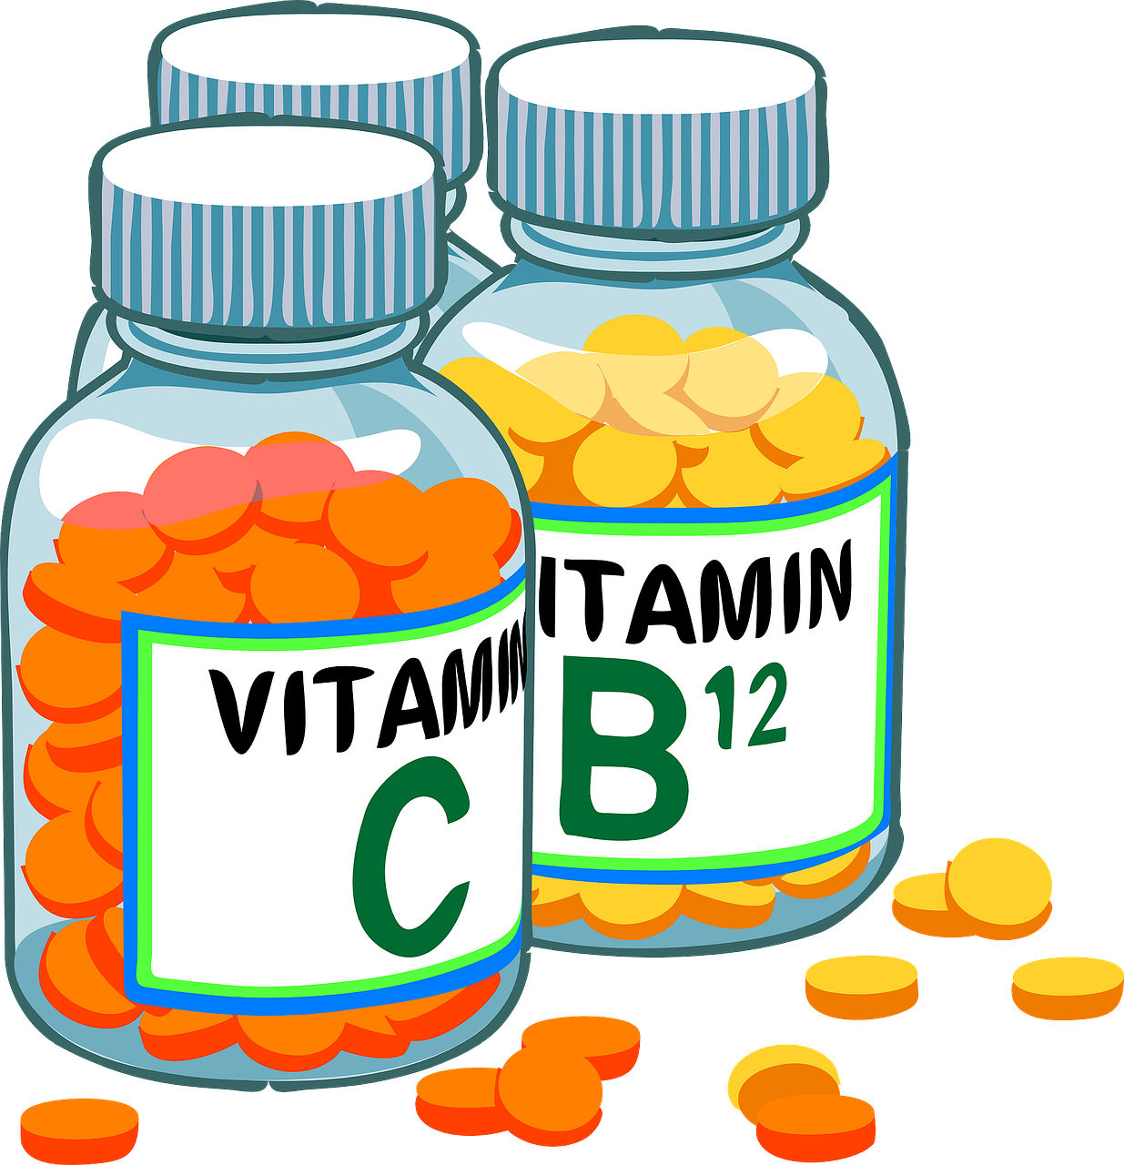
Human Health
02
Human Health in the Context of Global Change

Slide 15
What has Human Health to do with Global Change?
Climate change significantly impacts human health, which is increasingly evident through the escalation of heatwaves, heightened air pollution, and the proliferation of infectious diseases. Failure to act will worsen these issues, posing graver risks to both current and future generations' well-being. Over the next decade, environmental risks are set to dominate global challenges, all being directly related to, or consequences of, climate change.
https://www.weforum.org/agenda/2024/01/davos24-health-areas-impacted-climate-change-guidance/

Slide 16
Effects of Global Change to Human Health
Global change impacts human health both directly and indirectly.
Direct impacts include extreme weather events like heatwaves, rising sea levels, floods, droughts, and hurricanes, which can cause injuries, illnesses, and fatalities.
Indirect effects stem from environmental alterations, such as increased air pollution, which exacerbates respiratory and cardiovascular conditions.
Changes in temperature and rainfall patterns can influence the behavior and distribution of disease-carrying insects, leading to changes in infectious diseases.
https://www.niehs.nih.gov/research/programs/climatechange/health_impacts

Slide 17
Effects of Global Change to Human Health
Climatic shifts can result in more water-related illnesses due to increased precipitation, storm surges, and rising sea temperatures.
Climate change also poses risks to food safety, exposing individuals to contaminated foods and increasing the likelihood of foodborne illnesses.
Mental health and well-being are also affected by climate change, contributing to increased stress, anxiety, and psychological distress among populations.
Exposure to climate-related hazards varies based on factors such as location, population demographics, and individual susceptibility.
https://www.niehs.nih.gov/research/programs/climatechange/health_impacts

Slide 18
Effects of Global Change to Human Health
Vulnerable populations may experience greater risks due to higher exposure, increased sensitivity to climate stressors, pre-existing health conditions, or limited resources for coping and adaptation.
Effective public health responses are crucial for mitigating climate-related health risks, preventing injuries and illnesses, and enhancing overall public health preparedness.
https://www.niehs.nih.gov/research/programs/climatechange/health_impacts

Slide 19
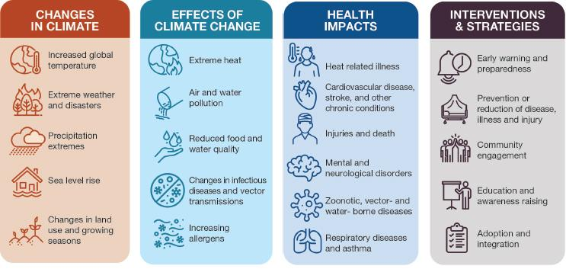
Effects of Global Change to Human Health
Picture taken from: https://www.niehs.nih.gov/research/programs/climatechange/health_impacts

Slide 20
Identify Direct and Indirect Health Impacts: Create a list of direct and indirect ways in which climate change affects human health based on the provided text. Categorize each impact accordingly.
Task

Slide 21
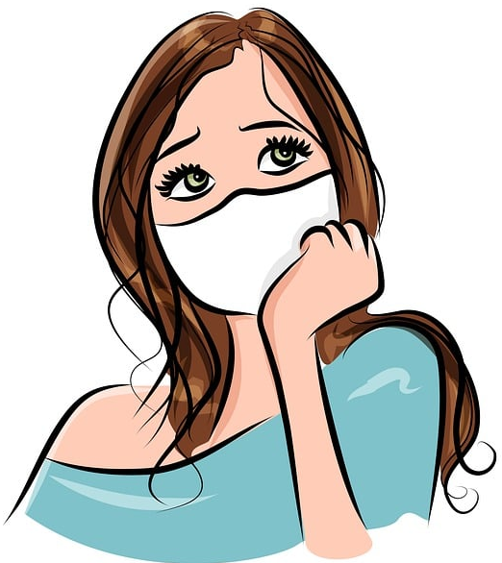
Global Change and Diseases
03
Pandemics, Epidemics and Infectious Diseases

Slide 22
Global Change and Diseases
Climate change, rapid urbanization and changing land-use patterns will increase the risk of disease emergence in the coming decades. Climate change, in particular, may alter the range of global pathogens, allowing infections, particularly vector-borne infections, to expand into new locations.
https://www.nature.com/articles/s41579-021-00639-z#:~:text=Climate%20change%2C%20rapid%20urbanization%20and,to%20expand%20into%20new%20locations.

Slide 23
Epidemics, Pandemics and Infectious Diseases
Recent decades have seen significant declines in mortality and morbidity, particularly in childhood mortality, due to advancements in public health, including greater access to care, improved sanitation, and the development of vaccines.
Despite medical advances, inequalities in access to healthcare and preventive measures persist, both between and within countries, underscoring the need for efforts to reduce disparities and improve surveillance for infectious diseases.
The emergence and re-emergence of infectious diseases pose a new threat to global health, driven by factors such as climate change, rapid urbanization, and changing land-use patterns
https://www.nature.com/articles/s41579-021-00639-z#:~:text=Climate%20change%2C%20rapid%20urbanization%20and,to%20expand%20into%20new%20locations.

Slide 24
Epidemics, Pandemics and Infectious Diseases
Climate change is expected to alter the distribution of global pathogens, increasing the risk of diseases, particularly vector-borne infections, expanding into new regions.
Global travel, trade, and mobility will facilitate the rapid transmission of pathogens, emphasizing the importance of investing in outbreak response and surveillance systems.
Efforts to develop universal vaccines hold promise in addressing present and future infectious diseases by providing broad immunity against various strains of viruses.
https://www.nature.com/articles/s41579-021-00639-z#:~:text=Climate%20change%2C%20rapid%20urbanization%20and,to%20expand%20into%20new%20locations.

Slide 25
Epidemics, Pandemics and Infectious Diseases
Future research must address concurrent changes in demographic, climatic, and technological factors to evaluate future risks of pathogen emergence and global spread.
Attention should be directed towards pathogens circulating in both wild and domestic animal populations, especially in areas where human activities encroach upon natural habitats.
Leveraging new technologies, such as advances in data collection and surveillance, is crucial for detecting and monitoring pathogen emergence and spread.
Collaboration and a global perspective are essential in the fight against infectious diseases, highlighting the need for a collaborative worldwide framework for research and control.
https://www.nature.com/articles/s41579-021-00639-z#:~:text=Climate%20change%2C%20rapid%20urbanization%20and,to%20expand%20into%20new%20locations.

Slide 26
Videos
03
Global Change and Diseases

Slide 27
Global Change
Watch the following Videos and take Notes

Slide 28
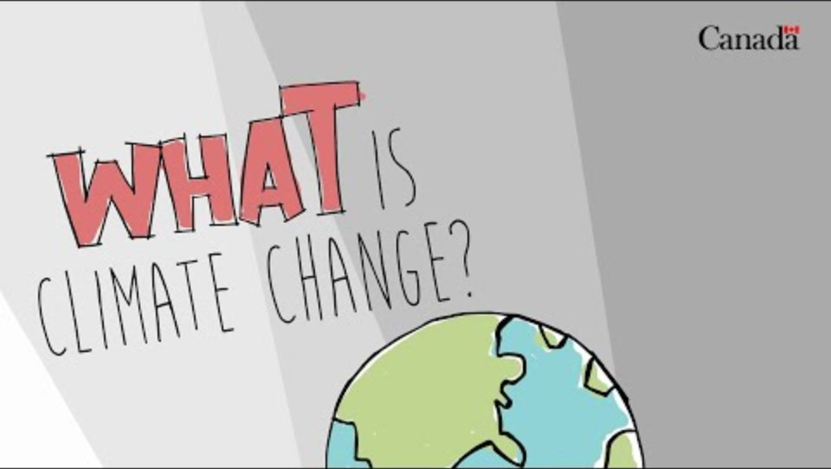
Climate Change Explained
Please Watch the Video
Take notes on the important facts
What does Climate Change mean?
Task
https://www.youtube.com/watch?v=QlQ-MEZgRGY

Slide 29
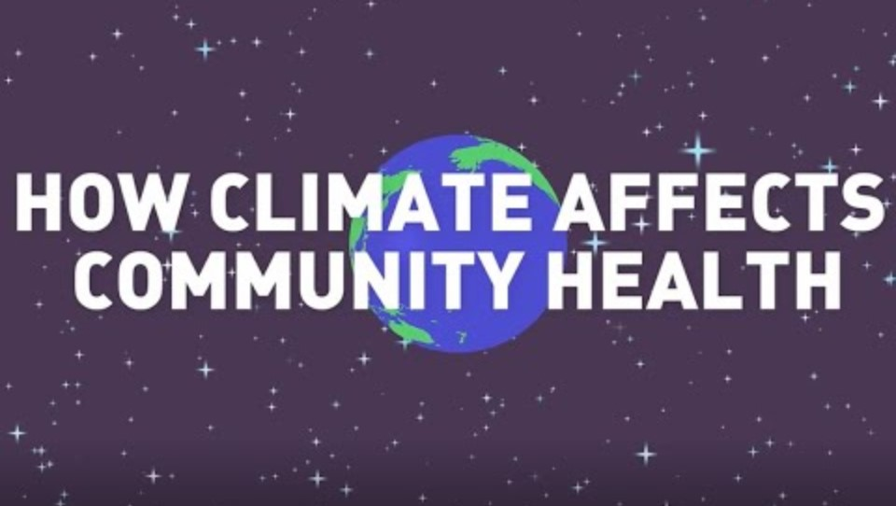
Climate Change vs. Health?
Please Watch the Video
Take notes on the important facts
How does Climate Change affect Community Health?
Task
https://www.youtube.com/watch?v=JywsWktvODc

Slide 30
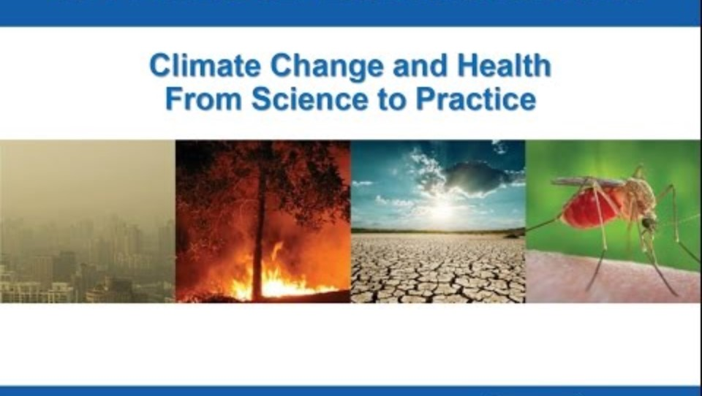
Lecture:
Climate Change and Health
Please Watch the Video
Take notes on the important facts
What are the correlations between Climate Change and Health?
Task
https://www.youtube.com/watch?v=6V_0JaE2Gz0

Slide 31
Self-Check
04
The Impact of Global Change on Human Health, Infectious, and Epidemic Diseases

Slide 32
What are core drivers of declines in mortality and morbidity in recent decades?
Increased air pollution levels
Greater access to care, including therapeutics and vaccines
Reduced investments in public health
Limited sanitation facilities
Self
Check
Notes:
Answer: B

Slide 33
What factors are contributing to the emergence and re-emergence of infectious diseases?
Declining global travel and mobility
Stable climate patterns
Rapid urbanization, changing land-use patterns, and climate change
Decreased investments in outbreak response
Self
Check
Notes:
Answer: C

Slide 34
How might climate change impact the spread of infectious diseases?
By decreasing the range of global pathogens
By limiting global travel and trade
By altering the distribution of pathogens, particularly vector-borne infections
By reducing the need for outbreak response efforts
Self
Check
Notes:
Answer: C

Slide 35
What is emphasized as crucial for detecting and monitoring pathogen emergence and spread?
Advancements in data collection and surveillance
Global travel restrictions
Decreased investments in healthcare infrastructure
Reliance on outdated surveillance methods
Self
Check
Notes:
Answer: A

Slide 36
References and Links
Abbass, K., Qasim, M. Z., Song, H., et al. (2022). A review of the global climate change impacts, adaptation, and sustainable mitigation measures. Environmental Science and Pollution Research, 29, 42539–42559. https://doi.org/10.1007/s11356-022-19718-6
Baker, R. E., Mahmud, A. S., Miller, I. F., Rajeev, M., Rasambainarivo, F., Rice, B. L., Takahashi, S., Tatem, A. J., Wagner, C. E., Wang, L.-F., Wesolowski, A., & Metcalf, C. J. E. (2022). Infectious disease in an era of global change. Nature Reviews Microbiology, 20, 193-205.
Benoit, L., Thomas, I., & Martin, A. (2022). Review: Ecological awareness, anxiety, and actions among youth and their parents – a qualitative study of newspaper narratives. Child and Adolescent Mental Health, 27, 47-58. https://doi.org/10.1111/camh.12514
Better Health. (2024). Climate change and health. Accessed at 20th of March 2024 via: https://www.betterhealth.vic.gov.au/health/healthyliving/climate-change-and-health
Chu, E. W., & Karr, J. R. (2017). Environmental Impact: Concept, Consequences, Measurement. In Reference Module in Life Sciences (pp. B978-0-12-809633-8.02380-3). doi:10.1016/B978-0-12-809633-8.02380-3. Epub 2016 Oct 31. PMCID: PMC7157458.
Thomas, I., Martin, A., Wicker, A., & Benoit, L. (2022). Understanding youths' concerns about climate change: A binational qualitative study of ecological burden and resilience. Child Adolesc Psychiatry Ment Health, 16(1), 110. https://doi.org/10.1186/s13034-022-00551-1.
United Stated Environmental Protection Agency (EPA). (2024). Climate Change Impacts. Climate Change and Human Health. Accessed at 20th of March 2024 via: https://www.epa.gov/climateimpacts/climate-change-and-human-health#:~:text=Climate%20change%20affects%20the%20food,of%20certain%20pests%20and%20diseases.
Wipfli, H., & Withers, M. (2022). Engaging youth in global health and social justice: a decade of experience teaching a high school summer course. Global Health Action, 15(1987045). https://doi.org/10.1080/16549716.2021.1987045
World Economic Forum. (2024, January 16). Quantifying the impact of climate change on human health. Insight Report. Retrieved from https://www.weforum.org/publications/quantifying-the-impact-of-climate-change-on-human-health/

Slide 37
References and Links
World Economic Forum. (2024, January 16). Quantifying the impact of climate change on human health. Insight Report. Retrieved from https://www.weforum.org/publications/quantifying-the-impact-of-climate-change-on-human-health/
World Health Organization (WHO). (2023). Climate change. Accessed at 20th of March 2024 via: https://www.who.int/news-room/fact-sheets/detail/climate-change-and-health

Slide 38
Contact
Universität Paderborn
Department Wirtschaftspädagogik Lehrstuhl Wirtschaftspädagogik II Warburger Str. 100
33098 Paderborn
http://www.upb.de/wipaed

